Slide 1
Computer Vision Accelerators
Summer Internship 2023 – IT Labs
Analysis of Computer Vision tools for Object Detection

Slide 2
Index
Context and Objectives
Technologies Introduction
Problem, Motivation and Data
Models, Strategies and Results
Conclusions
References

Slide 3
Scope of Work
Context and Objectives

Slide 4

Scope of Work
Exploration of technologies using accelerators such as Microsoft's AI Builder and Google's Cloud Vision AI for use cases relevant to MC's business.
Develop a proof of concept for learning, demonstrating and validating technology and tools.
Identify advantages and disadvantages of the tools under study, as well as the effort required for their implementation.

Slide 5
Technologies Introduction
Microsoft vs Google
Choice of Technologies

Slide 6







AI Builder
Automatically creating models ready for use in PowerApps and Flows
Custom Vision
Automatically creating models that can exported or accessed online
Microsoft
Azure ML Workspace
Creation of custom models that demand a high level of complexity
We need an application that is ready to be used
Existing tools that abstract complexity
Computer Vision Accelerators
Vision API
Pre-trained machine learning models through REST and RPC APIs
Auto ML
Automatically creating models that can exported or accessed online
Google
Custom ML
Creation of custom models that demand a high level of complexity

Slide 7


 | Microsoft |  |  | Google
 | AI Builder | Custom Vision | Azure ML Workspace | Vision API | Auto ML | Custom ML
Automatic Model Creation
No Code Model Training
Custom Model Training
Model Deployment | Limited to PowerApps and Flows | Deployed online or locally | Deployed online or locally | Deployed online | Deployed online or locally | Deployed online or locally
Pricing – Cost Drivers | Minimum: 500$/Month Drivers: Images Processed Models Images per Training More Info | Drivers: Images Processed Training Hours Image Storage More Info | Custom More Info | Drivers: Type of Detection Images Processed More Info | Training: 18$/hour Deployment: 2$/hour Drivers: Images Processed Training Hours Deployment More Info | Drivers: Machine Type Accelerator Disk More Info

Slide 8
 | Microsoft |  |  | Google
 | AI Builder | Custom Vision | Azure ML Workspace | Vision API | Auto ML | Custom ML
Automatic Model Creation
No Code Model Training
Custom Model Training
Model Deployment | Limited to PowerApps and Flows | Deployed online or locally | Deployed online or locally | Deployed online | Deployed online or locally | Deployed online or locally
Pricing – Cost Drivers | Minimum: 500$/Month Drivers: Images Processed Models Images per Training More Info | Drivers: Images Processed Training Hours Image Storage More Info | Custom More Info | Drivers: Type of Detection Images Processed More Info | Training: 18$/hour Deployment: 2$/hour Drivers: Images Processed Training Hours Deployment More Info | Drivers: Machine Type Accelerator Disk More Info

Slide 9

Choice of Technologies
Microsoft
AI Builder
Google Cloud Vision Auto ML
Company is already integrated in Microsoft Technologies.
Good level of complexity abstraction.
No code model training and development.
Easy to build User Interface.
Good level of complexity abstraction.
No code model training and development.
Possibility to extract the model and use it in an external application.

Slide 10
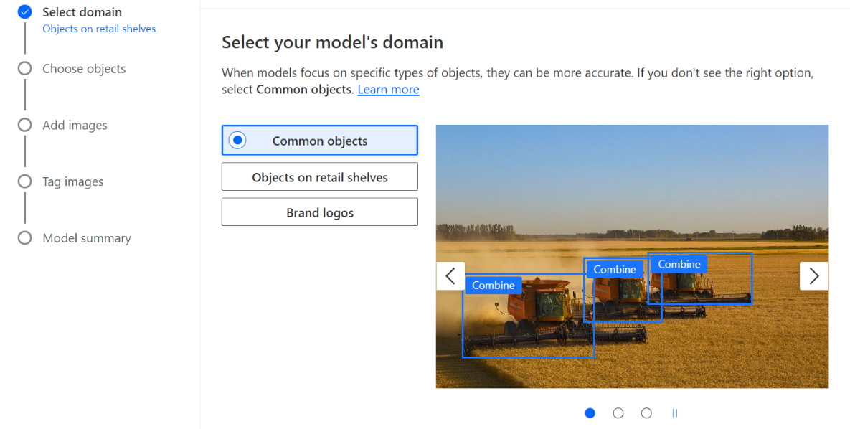
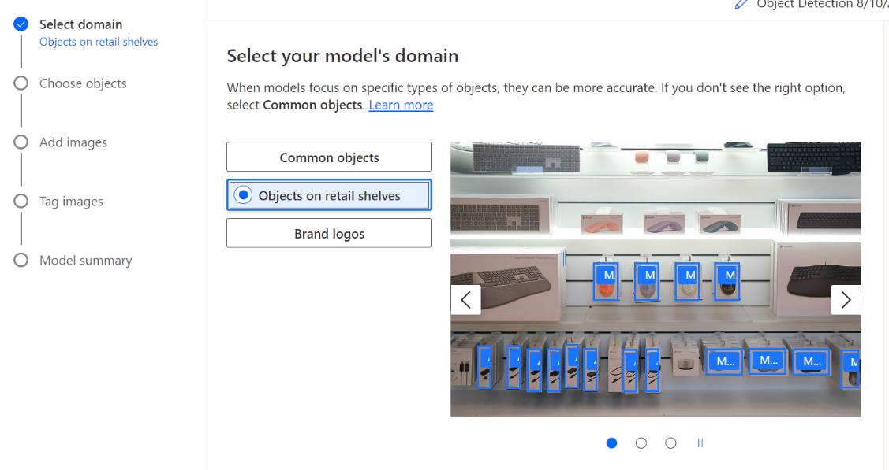
Microsoft AI Builder
AI Builder is a straightforward tool.
After selecting the Object Detection Model, there are three options, the one that was used was the Common objects.
There is also an option for Objects on retail shelves, for future investigation and testing in different use cases.

Slide 11
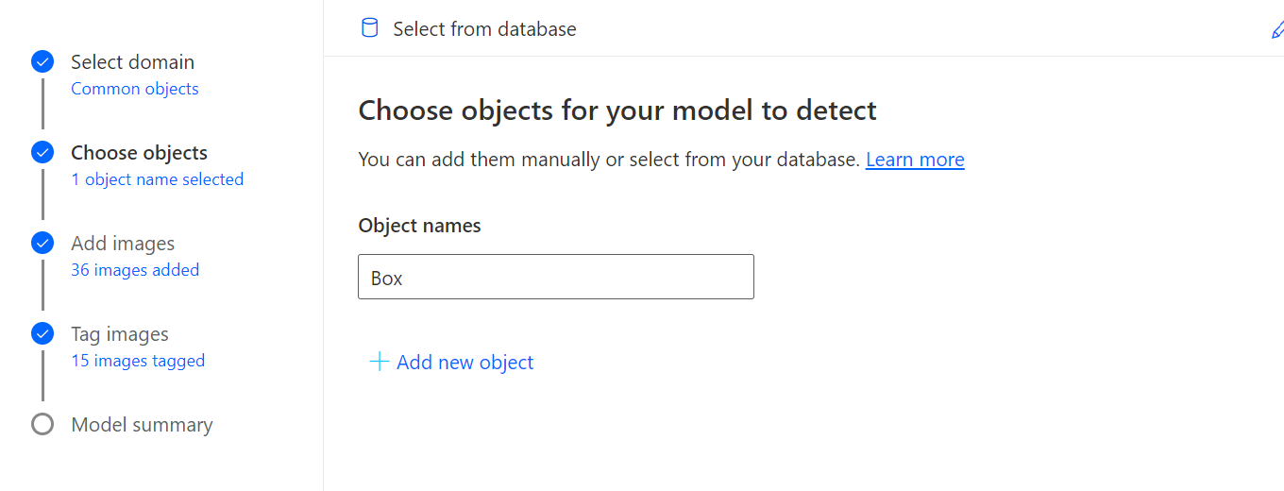
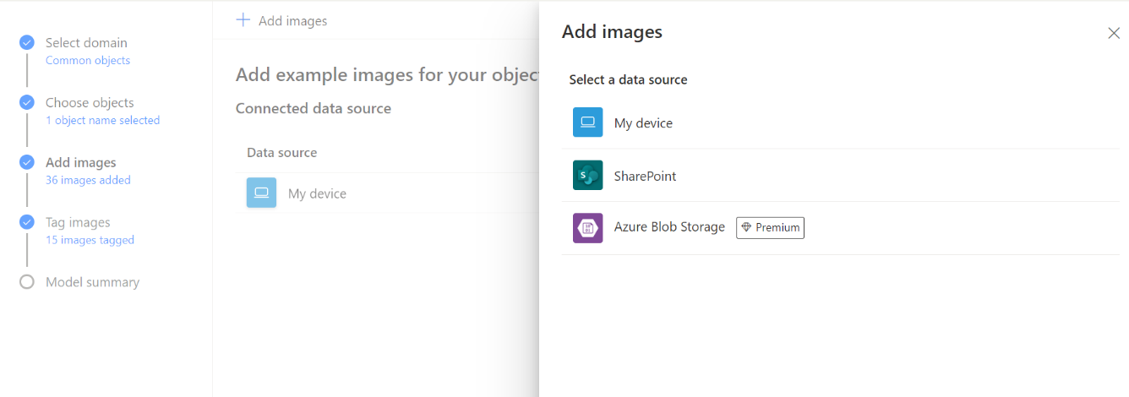
Microsoft AI Builder
The images need to have the following characteristics:
Format: JPG, PNG, BMP.
Size: maximum 6MB, minimum width / height 256 x 256 pixels.
Have at least 15 images per object for the training set.
Images with different lighting, sizes and capture different parts of the object.

Slide 12
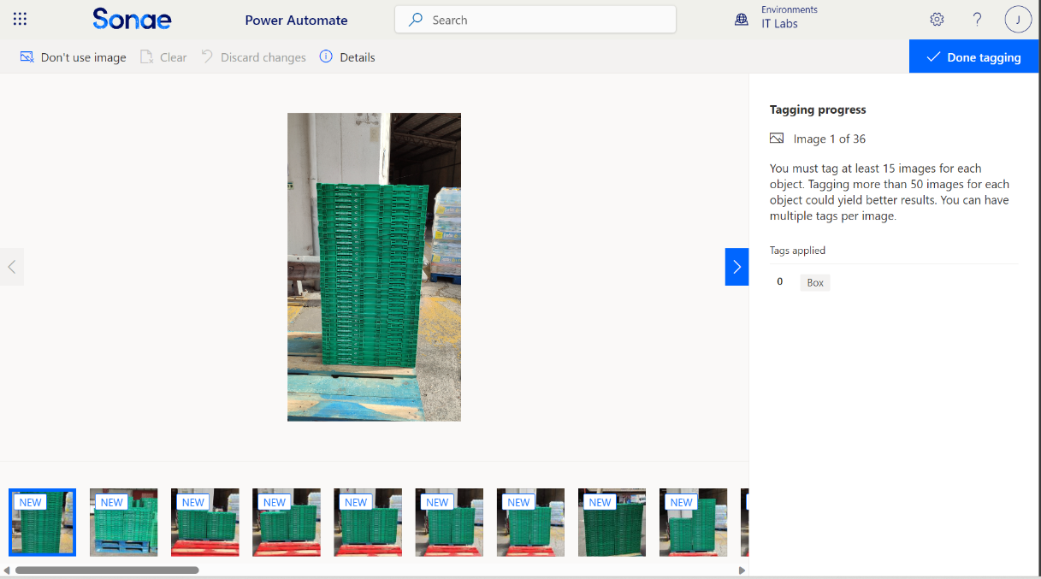
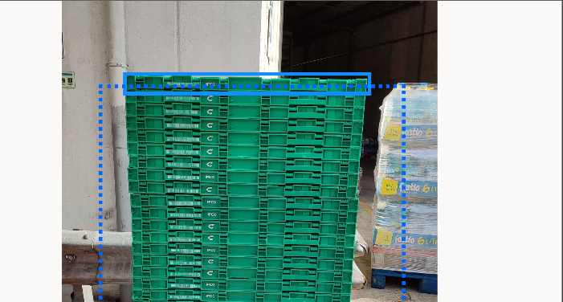
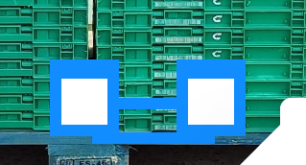
Microsoft AI Builder
After uploading the images, there is a tagging process to train the model identify the boxes.
The tagging process occurs in the browser and is up to the developer to identify the boxes manually.
Since individual boxes were too small, the difficulty of the task increases and it is needed to zoom the browser for a better selection.
The selector tool had a minimum height and some images have boxes smaller than that height.

Slide 13
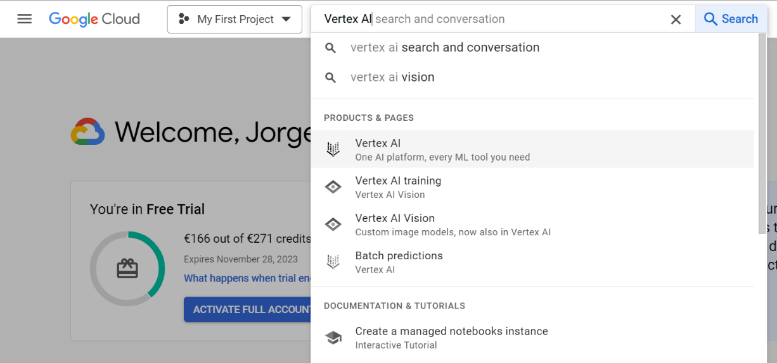
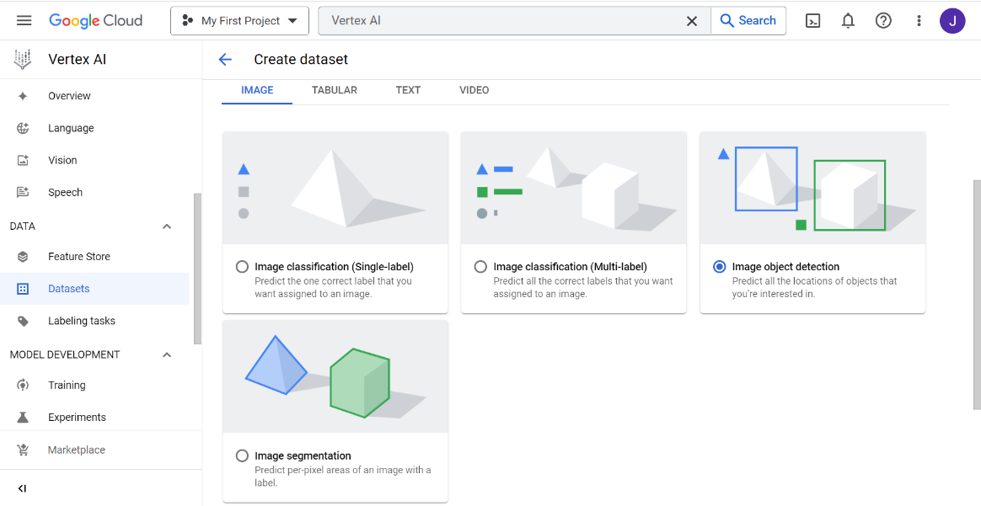
Google Auto ML
Need to have access to Google Cloud.
Search for Vertex AI.
There was created a Dataset, and the option for this Use Case was the “Image Object Detection”.

Slide 14
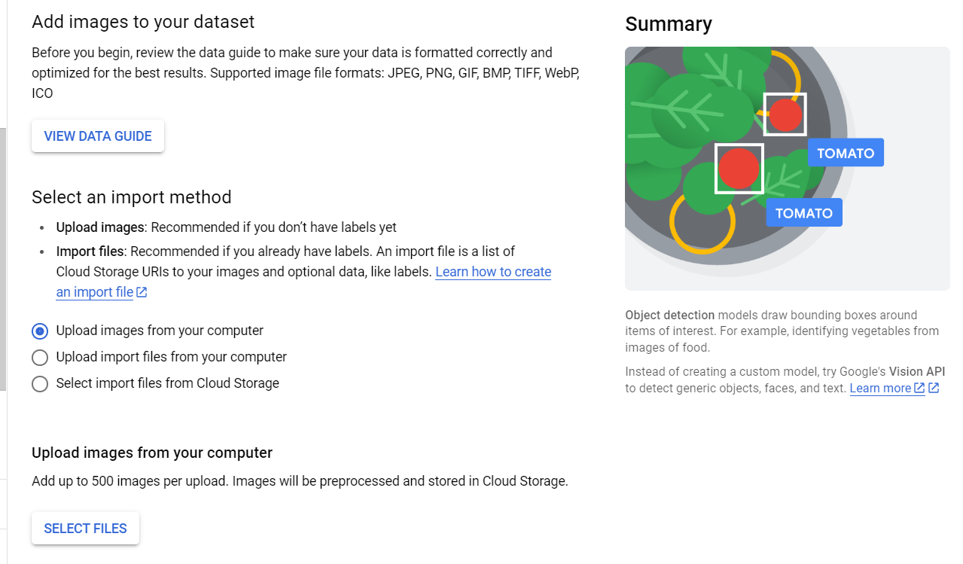
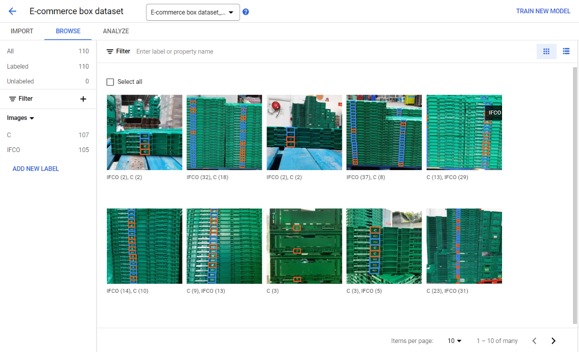
Google Auto ML
There is needed 10 images per object annotation to train the model.
We can see more accurately the information regarding the annotation process and the number of annotations in each image.

Slide 15
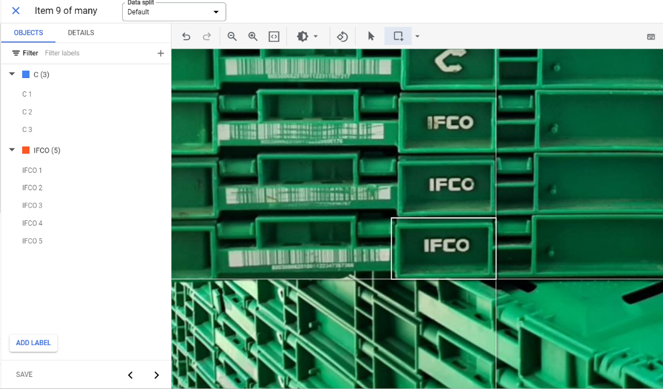
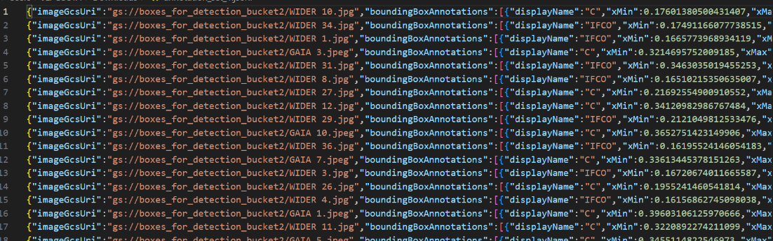
Google Auto ML
The process of annotation is more accessible, since it can be zoomed as much as possible.
There is also an option of importing an existing annotation set previously exported as a JSON file.

Slide 16
Use Case
Problem, Motivation and Data Collection

Slide 17
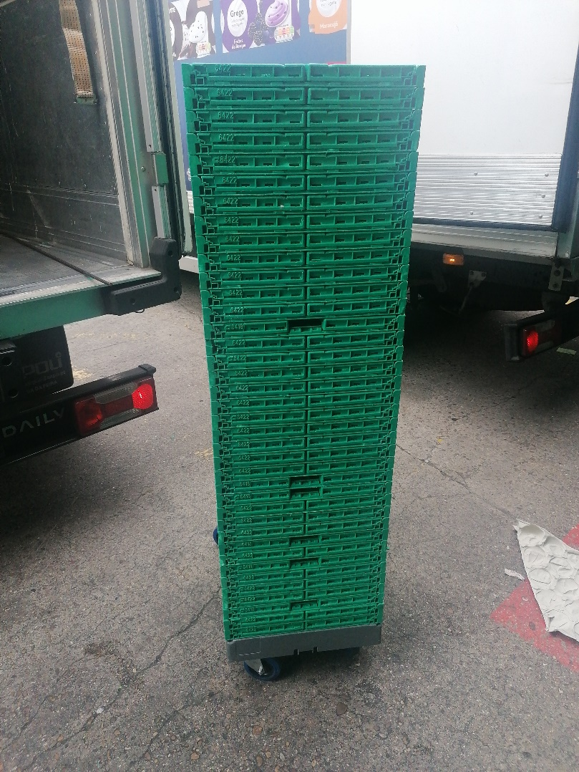
Problem and Motivation
In e-commerce operation and preparation of orders, it is known the number of expedition boxes that are dispatched, but we do not know the number of boxes that return to store.
During the inventory of the number of those boxes, there is a mismatch in that number, that causes an expense.
It formed a need of recording that data, in a process that should not affect the productivity of the e-commerce team.
The solution is to make a mobile application capable of counting those numbers of boxes and record it with a single photograph in a single action so the impact on the process and time spent is minimized.

Slide 18
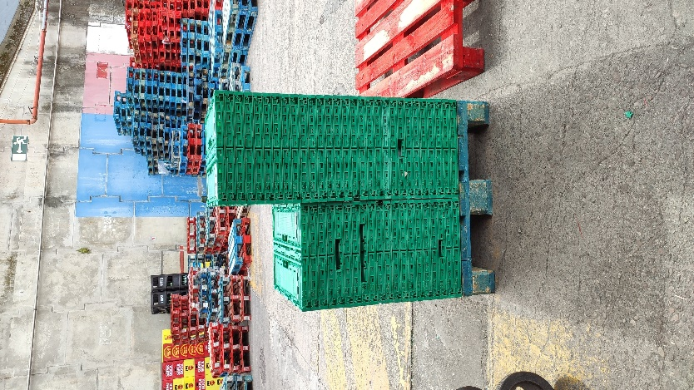
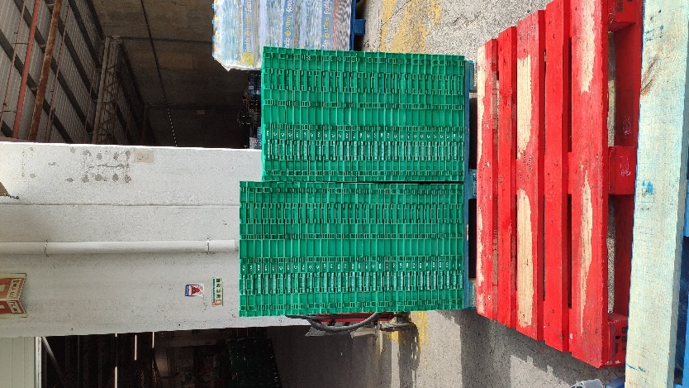
Data Collection
There was given already a set of 85 photos, in a narrow and wider perspective.
To increase the dataset, it was also collected a set of 210 photos.
For training purposes the photos vary in terms of lighting, distance, perspective, volume and resolution.
Narrow
Wider

Slide 19
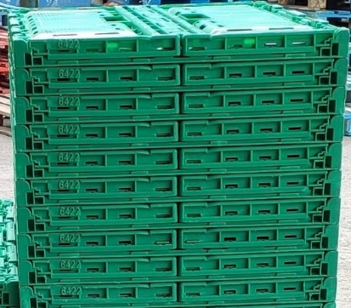
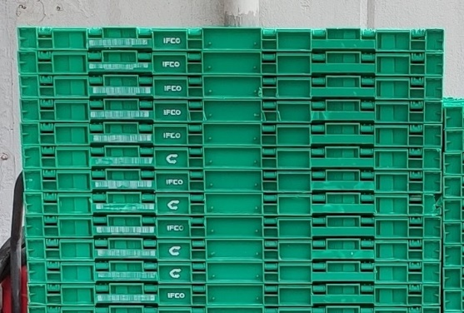
Data Collection
Due to the short duration of the project, it was necessary to choose and focus on either the narrow or wider perspective. These perspectives differ in shape and patterns, and opting for both would require additional types of training.
The wider perspective was chosen for training because it features simpler and more easily detectable patterns.
Note that there are two types of wider boxes: one with a 'C' symbol and the other with an 'IFCO' symbol.
If there are additional types of boxes, a different type of training will be required.
Narrow
Wider

Slide 20
Models and Strategies
Microsoft AI Builder vs Google Cloud Vision Auto ML - Explorations and Results

Slide 21




Microsoft AI Builder - Explorations and Results

Slide 22
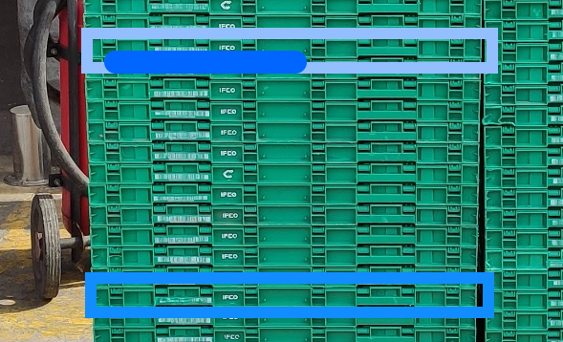
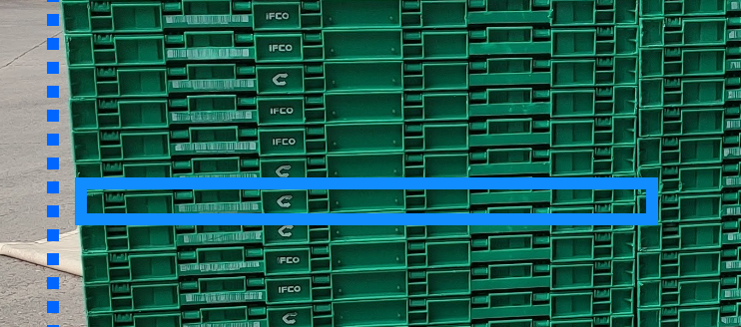
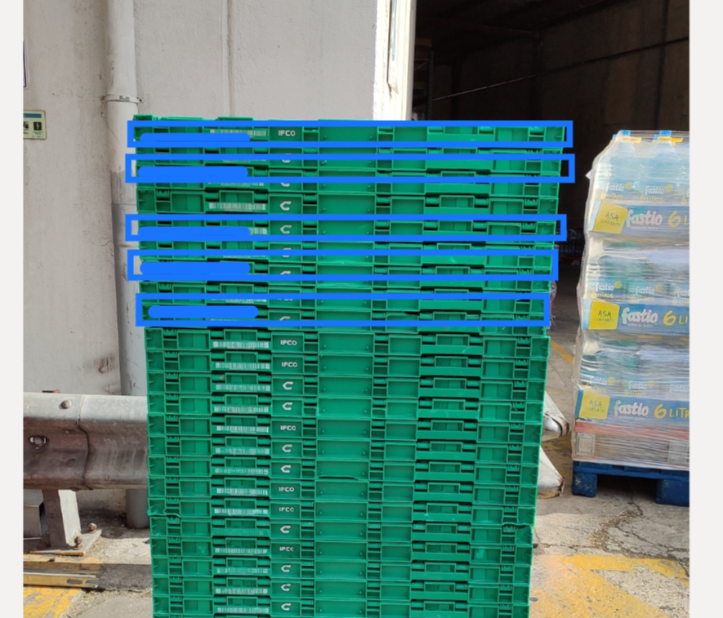
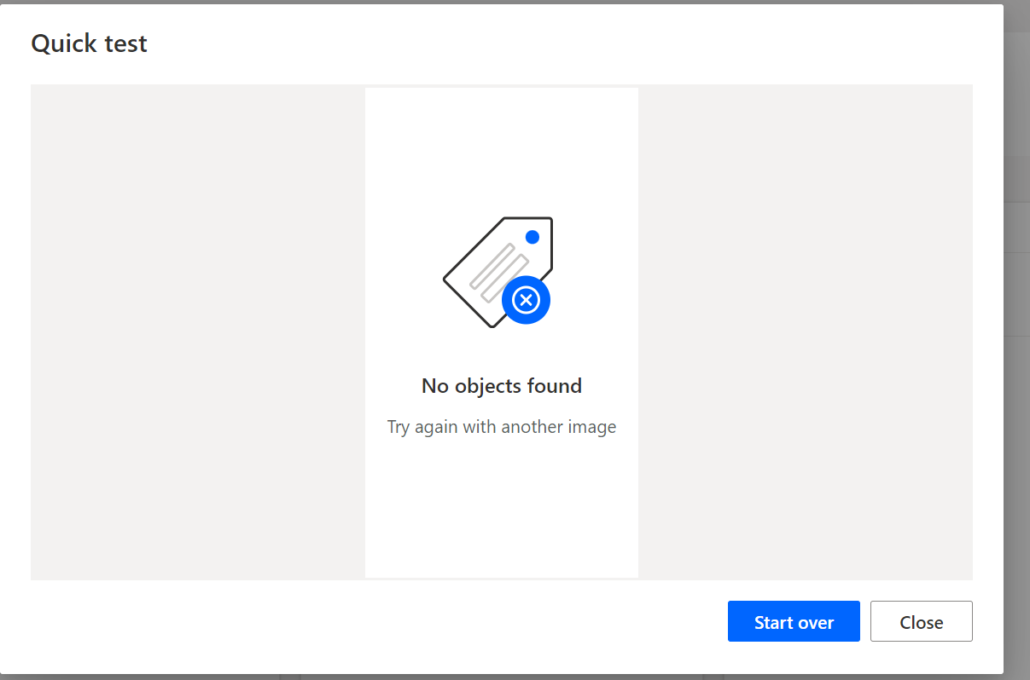
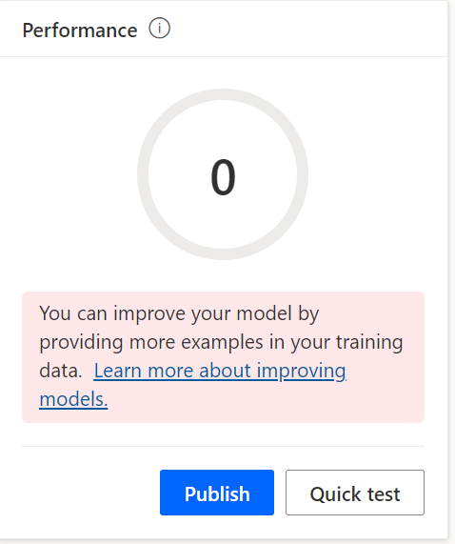
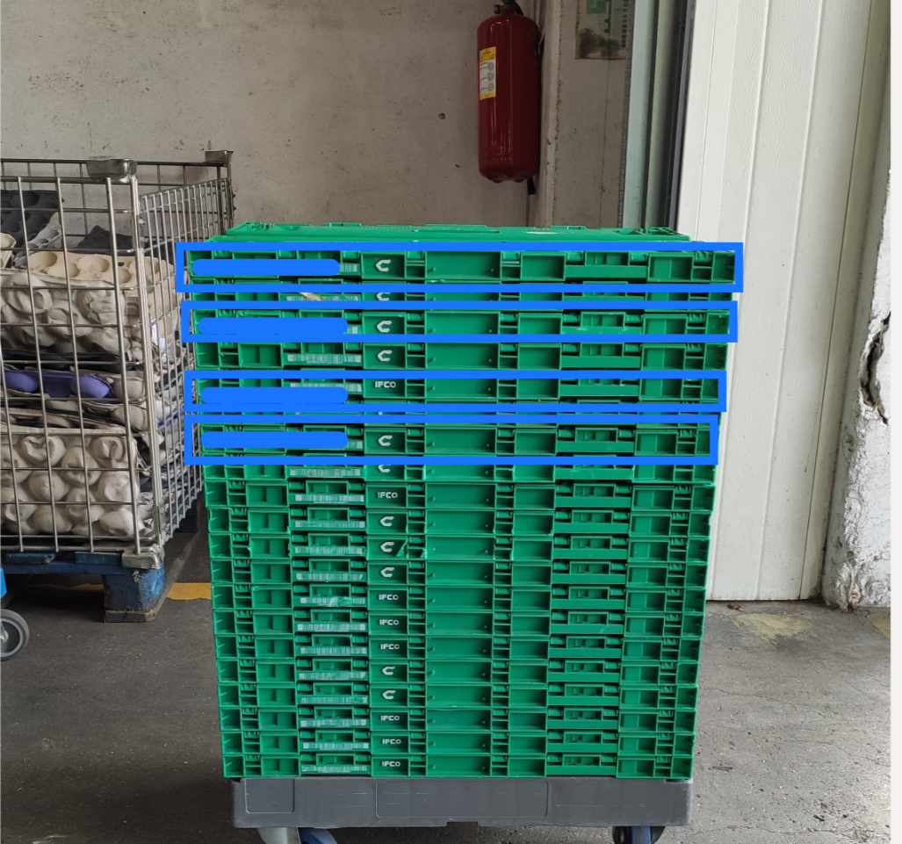
1. Box Detection Total Box
As mentioned before, the tagging process was difficult, and due to the angle and height of some boxes it was impossible to make a good selection.
The Perfomance Result of the model was 0.
It could detect some boxes in some images, but couldn’t detect none in others.

Slide 23
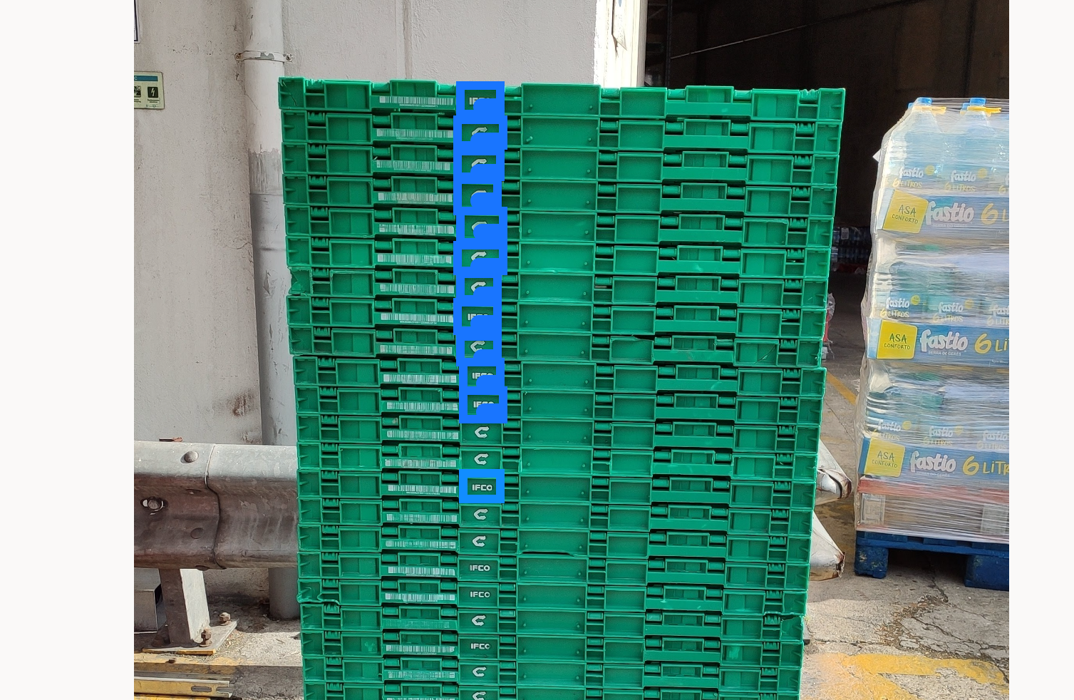
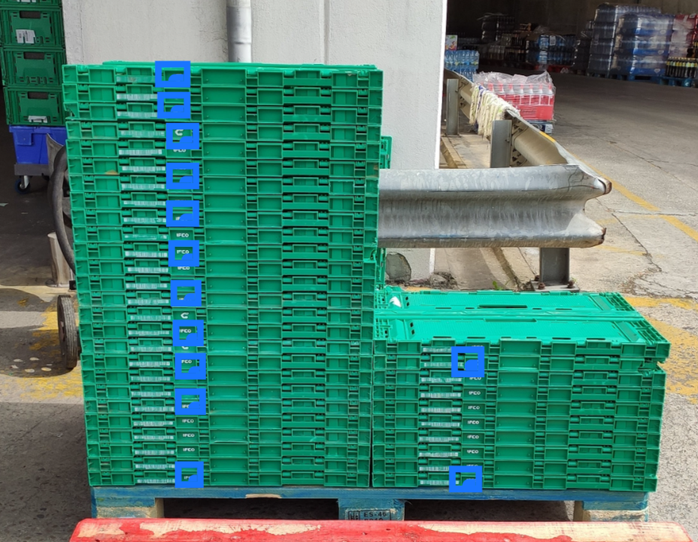
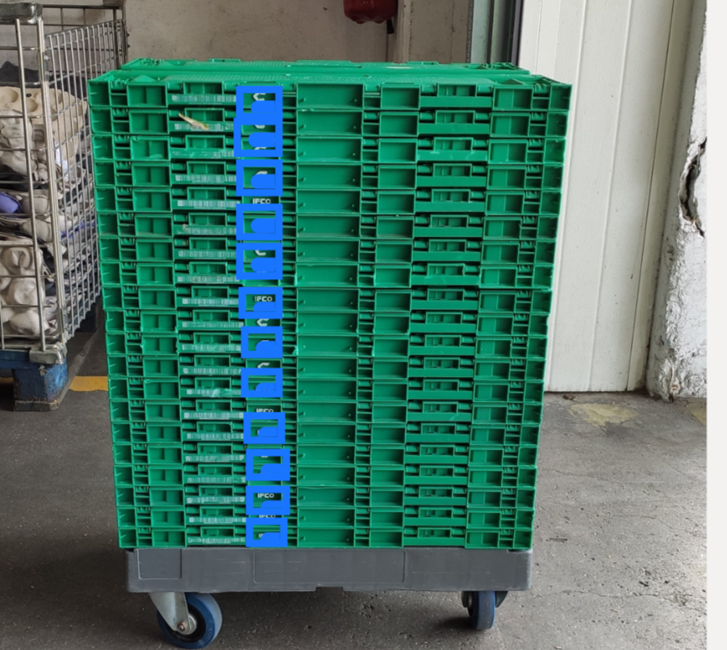
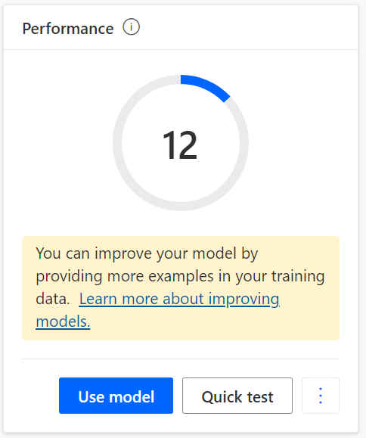
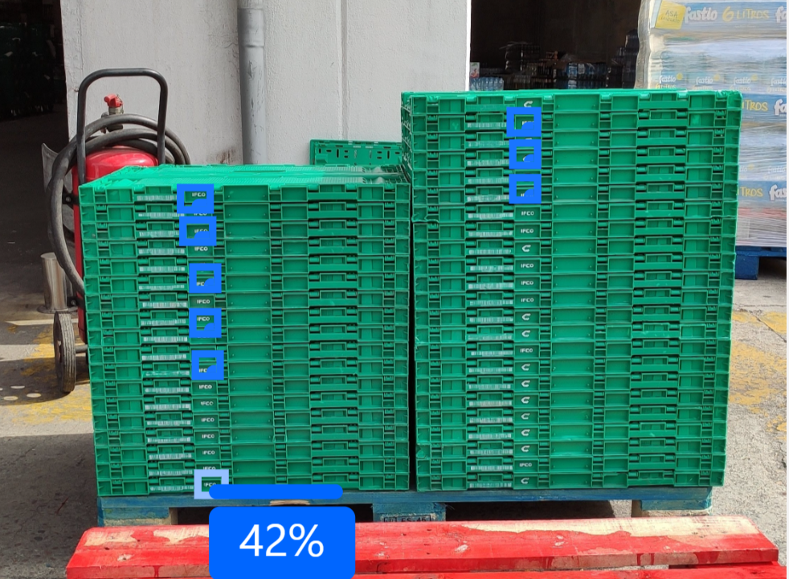
2. Box Detection Letter Symbol
Using a small fraction of the box with a Symbol could help the AI model since it was more distinguishable.
The Perfomance Result of the model was 12.
It detected a higher number of boxes, and consecutive ones.

Slide 24
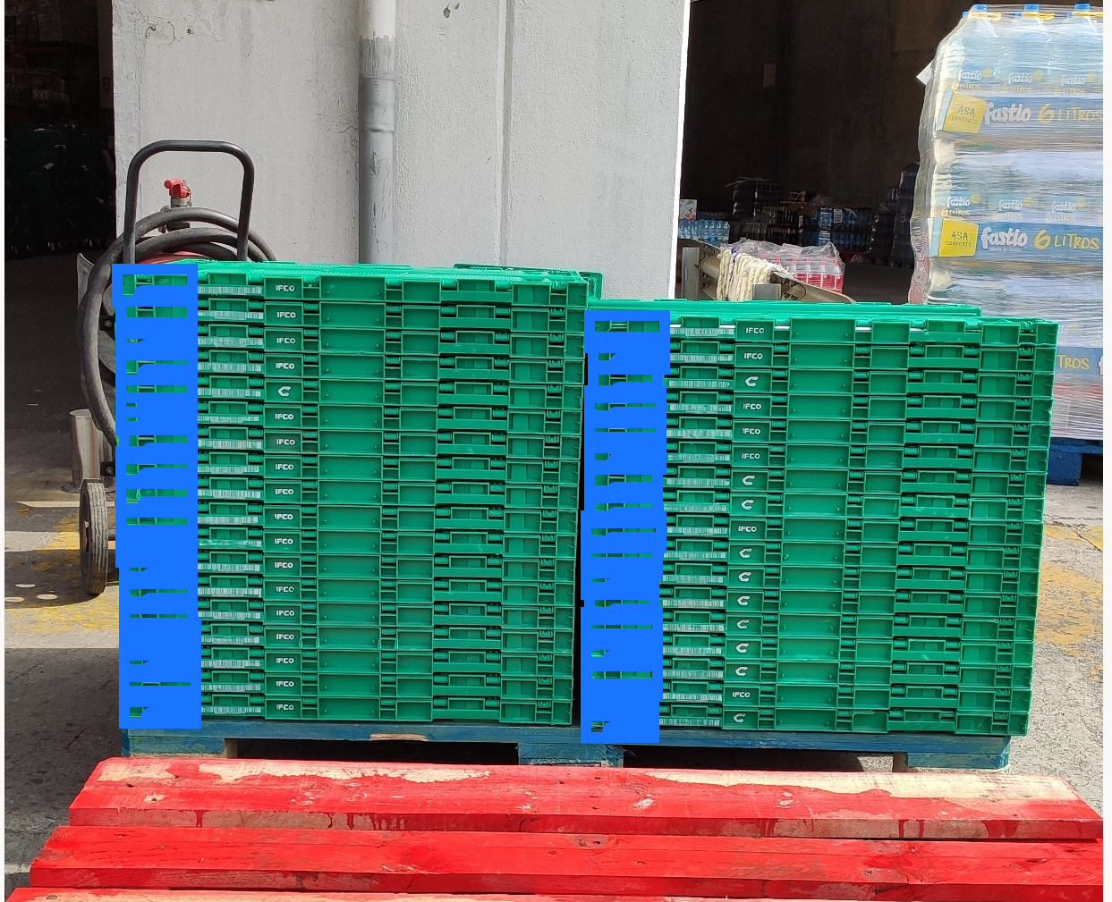
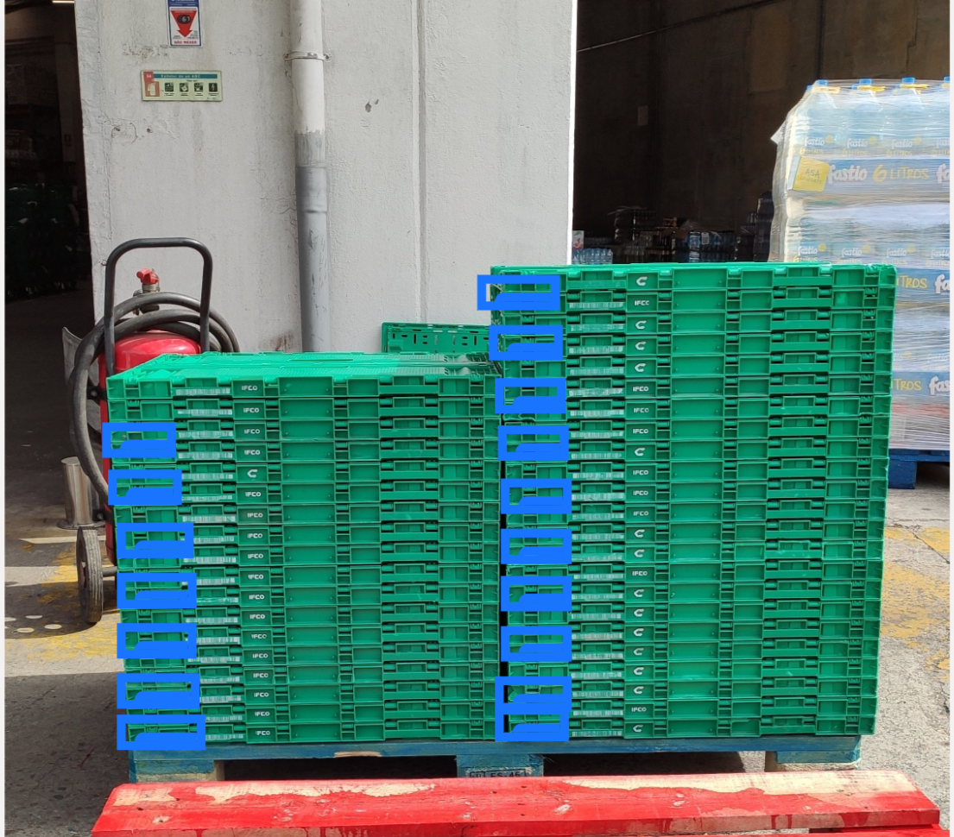
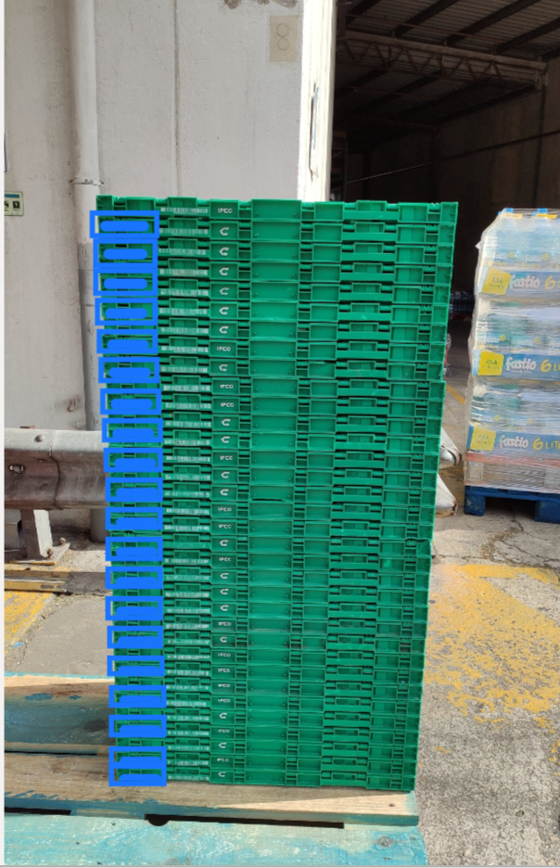
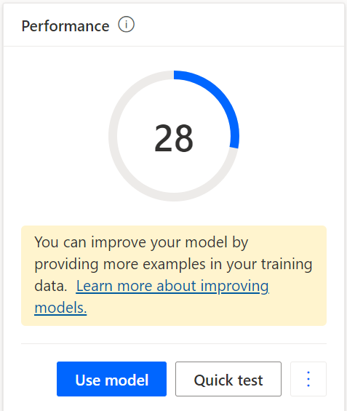
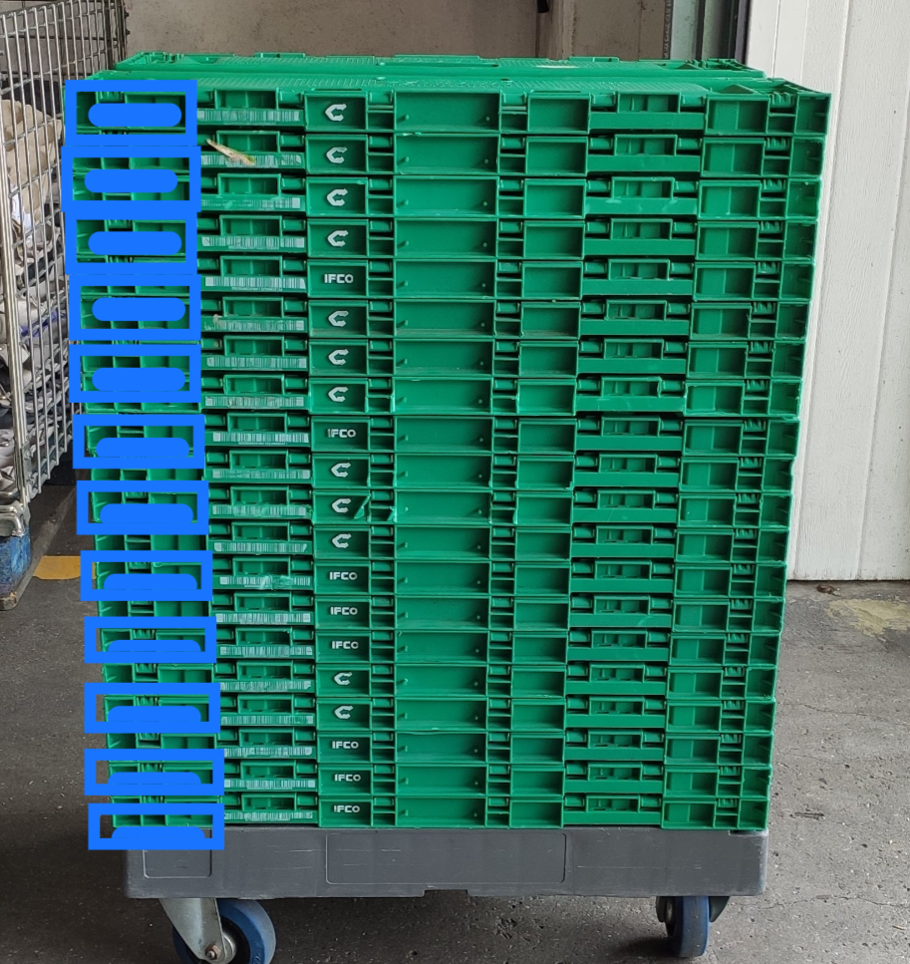
3. Box Detection Left Corner
Experiment with a different part of the box, having a small patern and border of box.
The Perfomance Result of the model was 28.
In this model there was selected a very high number of tags.
Could detect more boxes in the bottom of the stack, but there was a lot overlapping detections

Slide 25
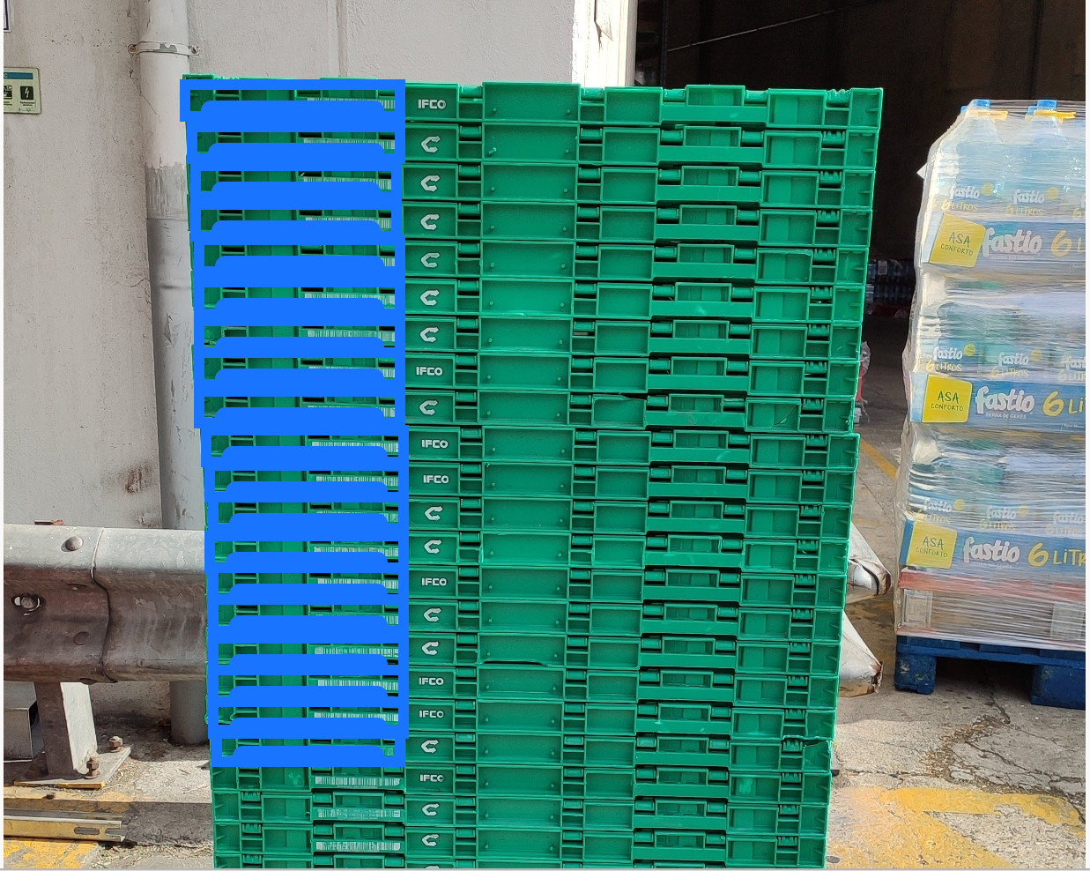
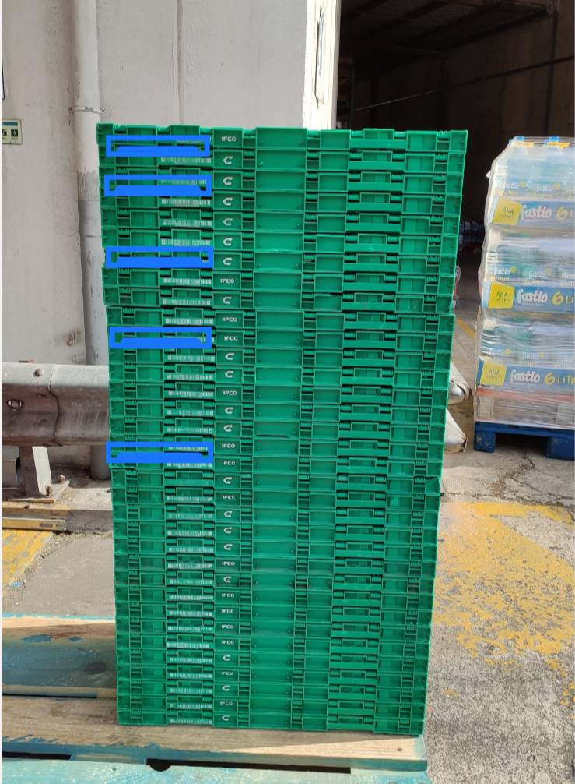
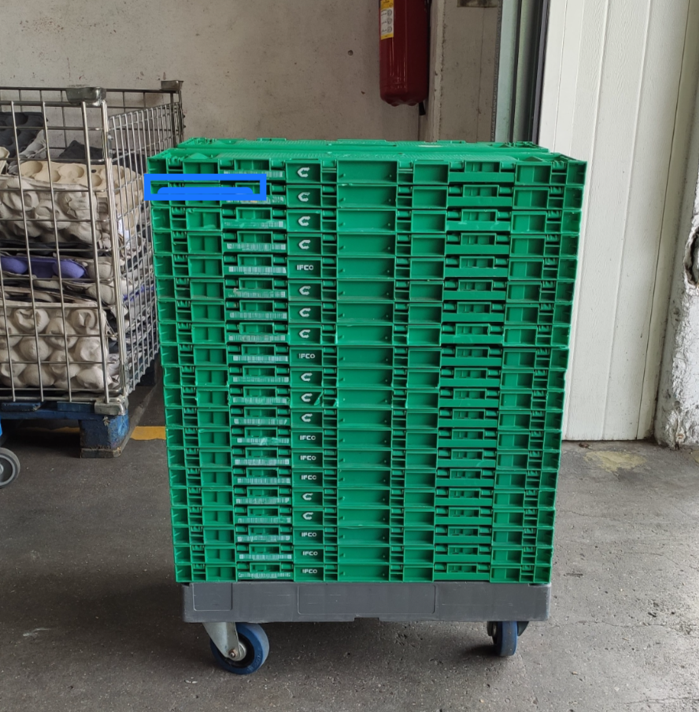
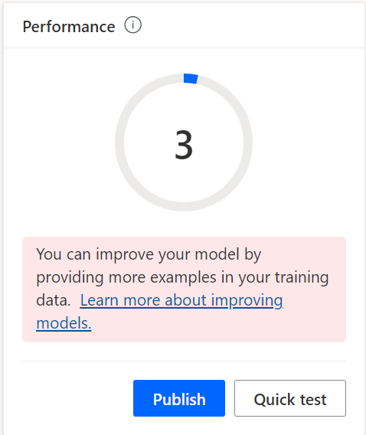
4. Box Detection Left Corner with Barcode
The idea was to identify the corner pattern toghether with the Barcode of the box the get a higher specificity.
The Perfomance Result of the model was surprisingly low.
It was one of the models with less detections.

Slide 26
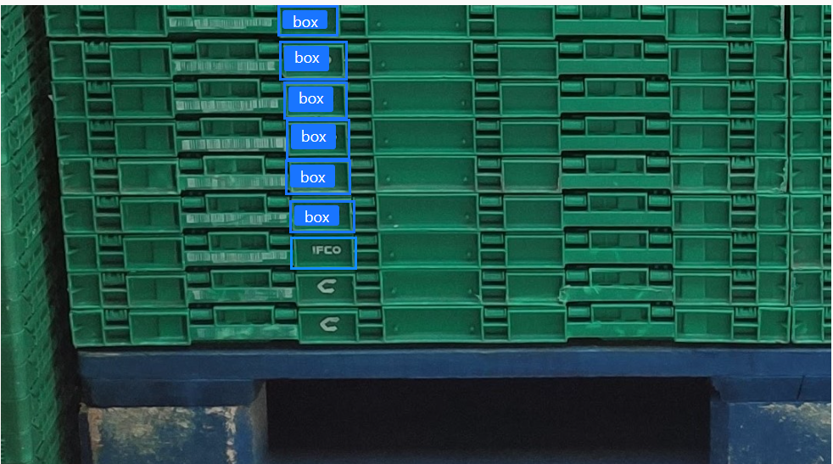
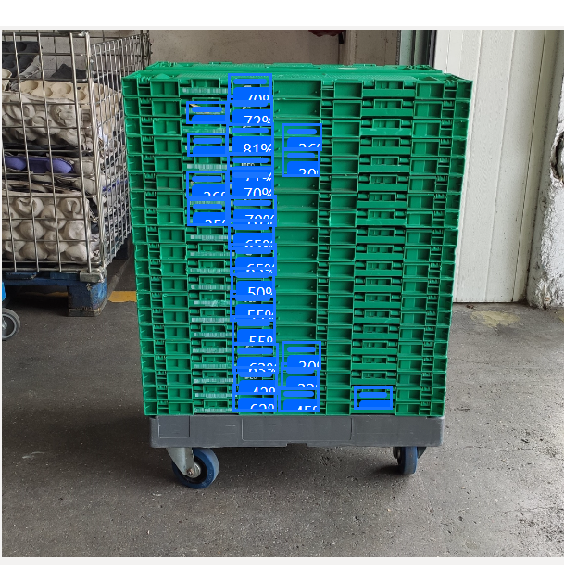
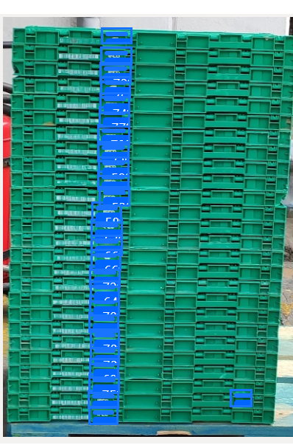
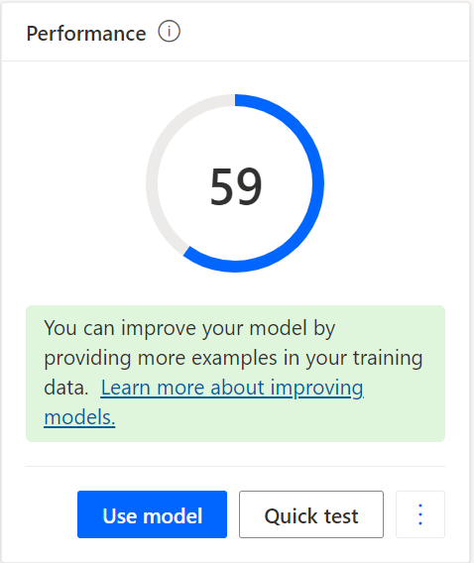
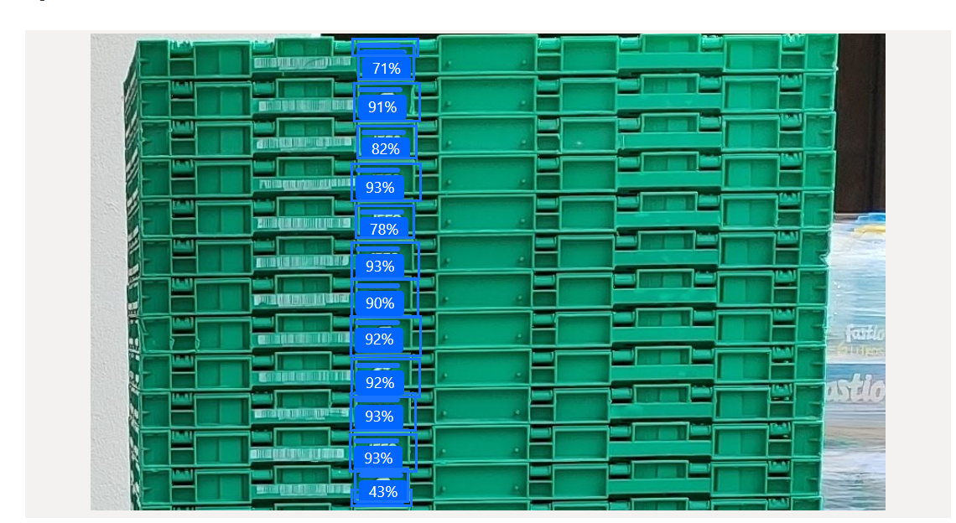
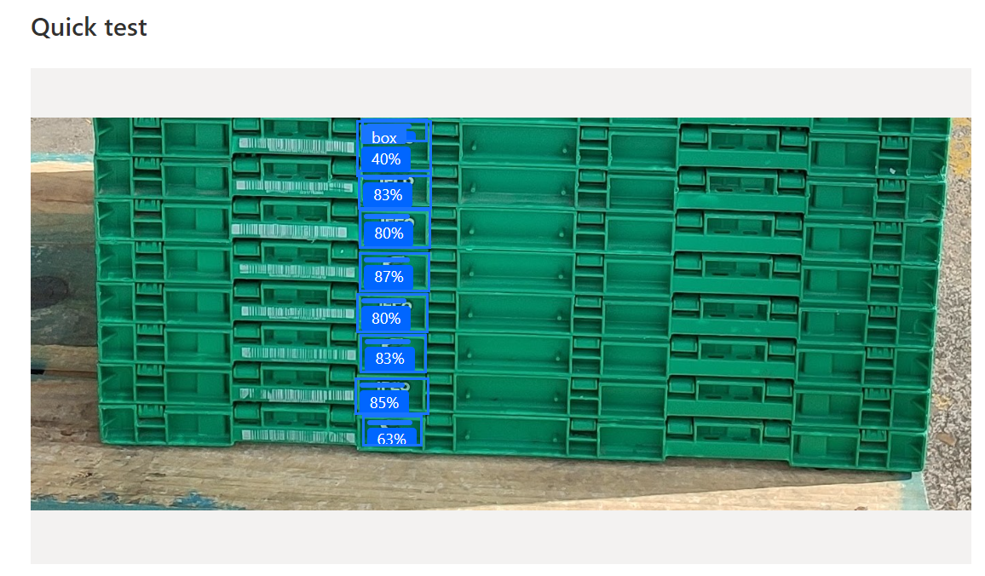
5. Box Detection with Image Parts Symbol Letter
In this model, the images were cropped so that the boxes could be bigger and the model could have a better detection. It was tested with the Symbol part.
The Perfomance Result was the best so far.
It was the model with better % of detections.

Slide 27
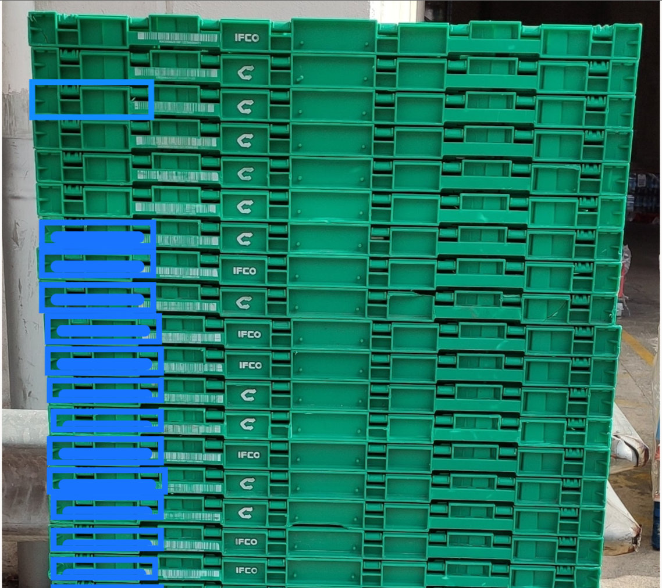
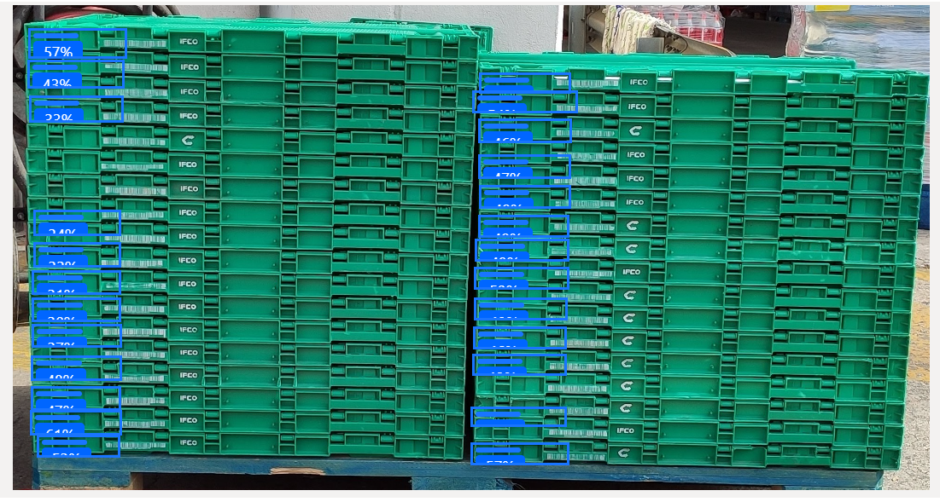
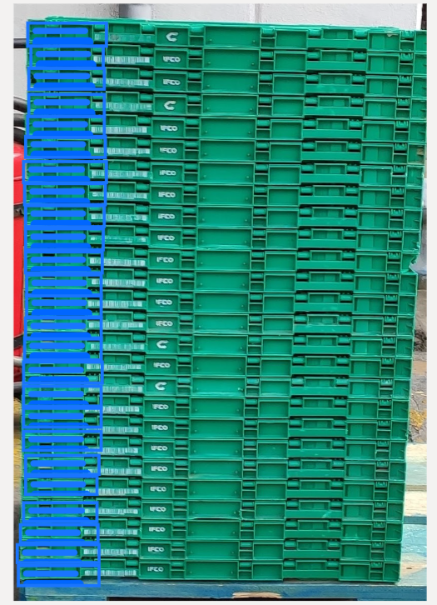
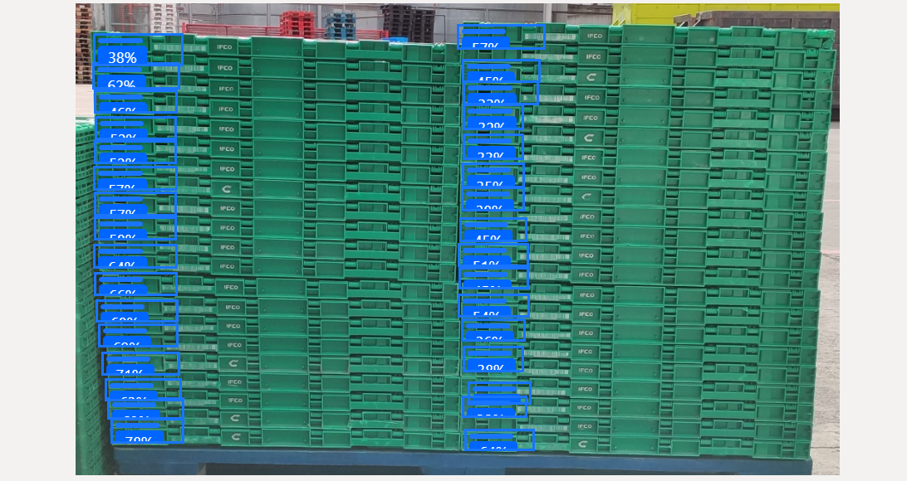
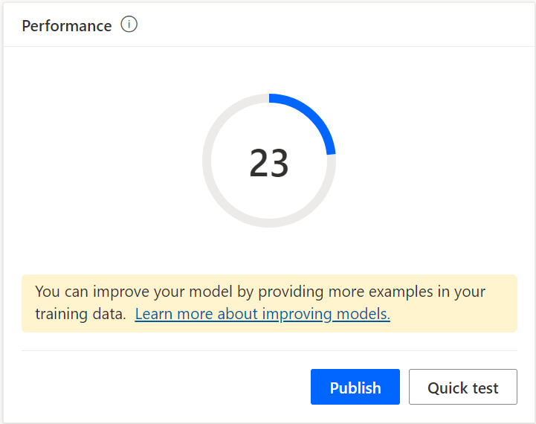
6. Box Detection Cropped Left Corner
Cropped images showing all stack.
The Perfomance Result was 23.
Some missing and overlapping detections.

Slide 28
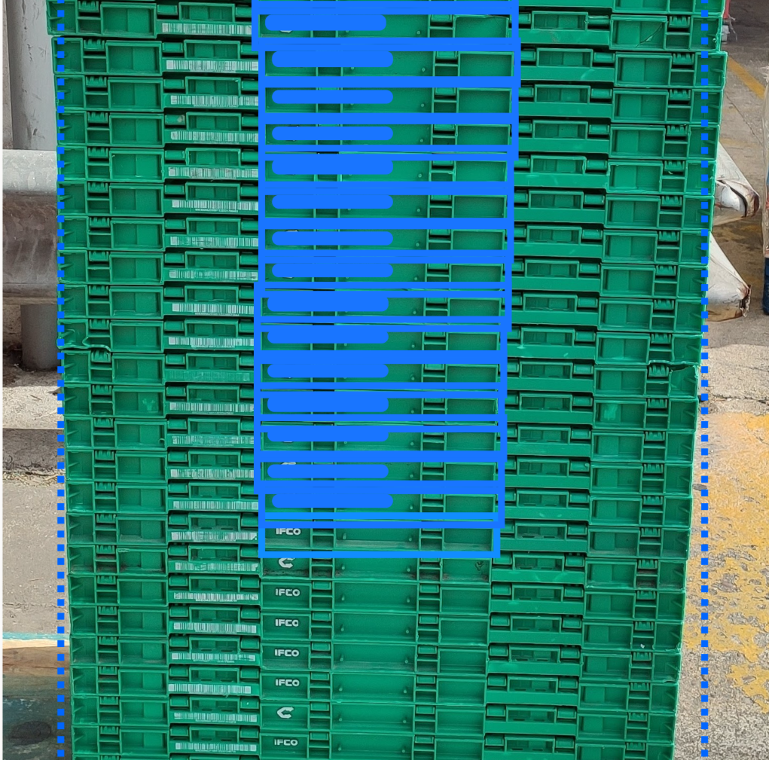





7. Box Detection Cropped Center
In this model was used a mix of cropped images enhancing the stack and others with some parts of the stack and was selected the center of box.
The Perfomance Result was lower than expected.
There was high hopes on this model since it took a lot of selections and each one being precise.
Still gave a lot of missing detections.

Slide 29
Model Evaluation
Models with better results: 5, 6, 7, 8.
Each training took approximately 10 to 20 minutes.
The approach chosen for further development and testing was the Model 5 - Box Detection with Image Parts Symbol Letter.
Recommendations based on results:
Box stack fit to image.
High number of images and tag selections.
Patterns with lot of details can confuse the model, so selecting a simple distinguishable part is the best choice.
Box Detection with Image Parts Symbol Letter

Slide 30



Model Evolution and Testing
Metrics:
“Out of all the positive predictions we made, how many were true?”
“Out of all the data points that should be predicted as true, how many did we correctly predict as true?”
Combination of Precision and Recall
I initially chose 5 images for testing but later increased that number to 10. I conducted tests using the model chosen with Microsoft AI Builder.

Slide 31
Model Evolution and Testing
It was used the same images for test in the various iterations.
It was also calculated the respective metrics based on the increment of the number of images and tags.

Slide 32










Images for testing

Slide 33






Testing Interface

Slide 34
Microsoft AI Builder
There is an increase in all values with a higher number of tags and images, but it stagnates after version 4.
The maximum value of F1 Score registed is about 93%.

Slide 35
Google Cloud Vision Auto ML – Exploration and Results

Slide 36

Google Auto ML
Google Auto ML has two options to train a model:
Cloud – the model is deployed to an endpoint and the predictions are made online, which theoretically have higher accuracy, but the cost is higher.
Edge – the model can be exported and used on an exterior application, the cost is lower but theoretically the accuracy is also lower.

Slide 37


Model and Approach
There was given an introduction of the technology by a Google collaborator and he suggested an approach for this use case.
Since the boxes have two different symbols, it was suggested to annotate two types for further training in which the model would detect the “C” and “IFCO” Symbols.
The training of the models took much longer, the last one reaching 4 hours.
The first produced model had a number of 80 Images and 2114 tags.
It was tested this same Dataset for the two different methods: Cloud and Edge.

Slide 38


Testing Interface
Auto ML automatically calculates a confidence threshold to consider when a prediction is true.
The counting is made with predictions which the confidence score higher than that value.
For example, if the recommended confidence threshold is 0.293, we only count the detections which have more than 0.293 confidence score.

Slide 39
After testing with the same 10 images it was registed that the Edge option has a higher F1 Score.

Slide 40

Evolution
Using the Edge method, the number of images and tags for training was increased.
It was noticed an even better result, increasing the F1 Score, and detecting almost every test image right.
There may still be room for improvement in the model's ability to predict images with much smaller boxes.

Slide 41




Slide 42
AI Builder Box Detection Symbol Duo Type Test
It was decided to also test the same approach in AI Builder for fair results.
The initial version of this model began with a large number of tags and images, resulting in a slower growth of the F1 Score compared to the previous model.
In this model, a greater number of images and tags were used, yet similar to the previous model, the curve demonstrates that the F1 Score is unlikely to reach higher values even with the addition of more images and tags."

Slide 43
Conclusions

Slide 44
Conclusions
In light of our previous experiences, Google Cloud Vision Auto ML delivered superior results for this specific use case:
AI Builder F1 Score: 93.23%
Auto ML F1 Score: 99.20%
Google's tools also enhance the user experience during development:
Image annotation can be managed more effectively with unrestricted zooming.
Annotation information is displayed more effectively.
Theoretically, Cloud-based training methods are more accurate than Edge-based methods, these results are particularly intriguing and greatly aid in decision-making, especially considering the cost-effectiveness of Edge methods.
Microsoft AI Builder remains a valuable accelerator tool due to its ease of creating a simple user interface, but it may not be the optimal solution for this use case.
The models performed better when tagging a specific/differentiable part of the box vs the whole box.
In general, the models performed better when processing images with larger boxes, either by taking photos closer to stack or cropping the images to the stack.

Slide 45
References
AI Builder Calculator | Microsoft Power Apps AI Services Pricing – Custom Vision Service | Microsoft Azure
Pricing Calculator | Microsoft Azure
Pricing | Cloud Vision API | Google Cloud
Pricing | Vertex AI | Google Cloud

